Slide 1
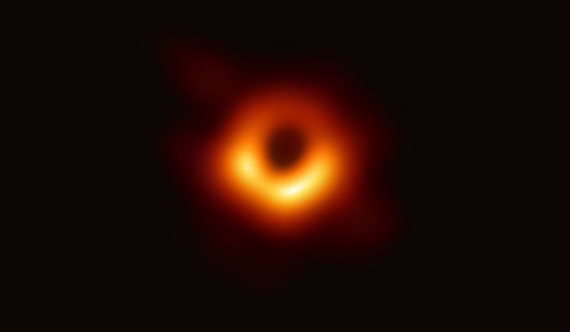
Finding Gravitational Background Radiation
Daniel Carson, Nathanael Ribar (LIGOIII)

Slide 2
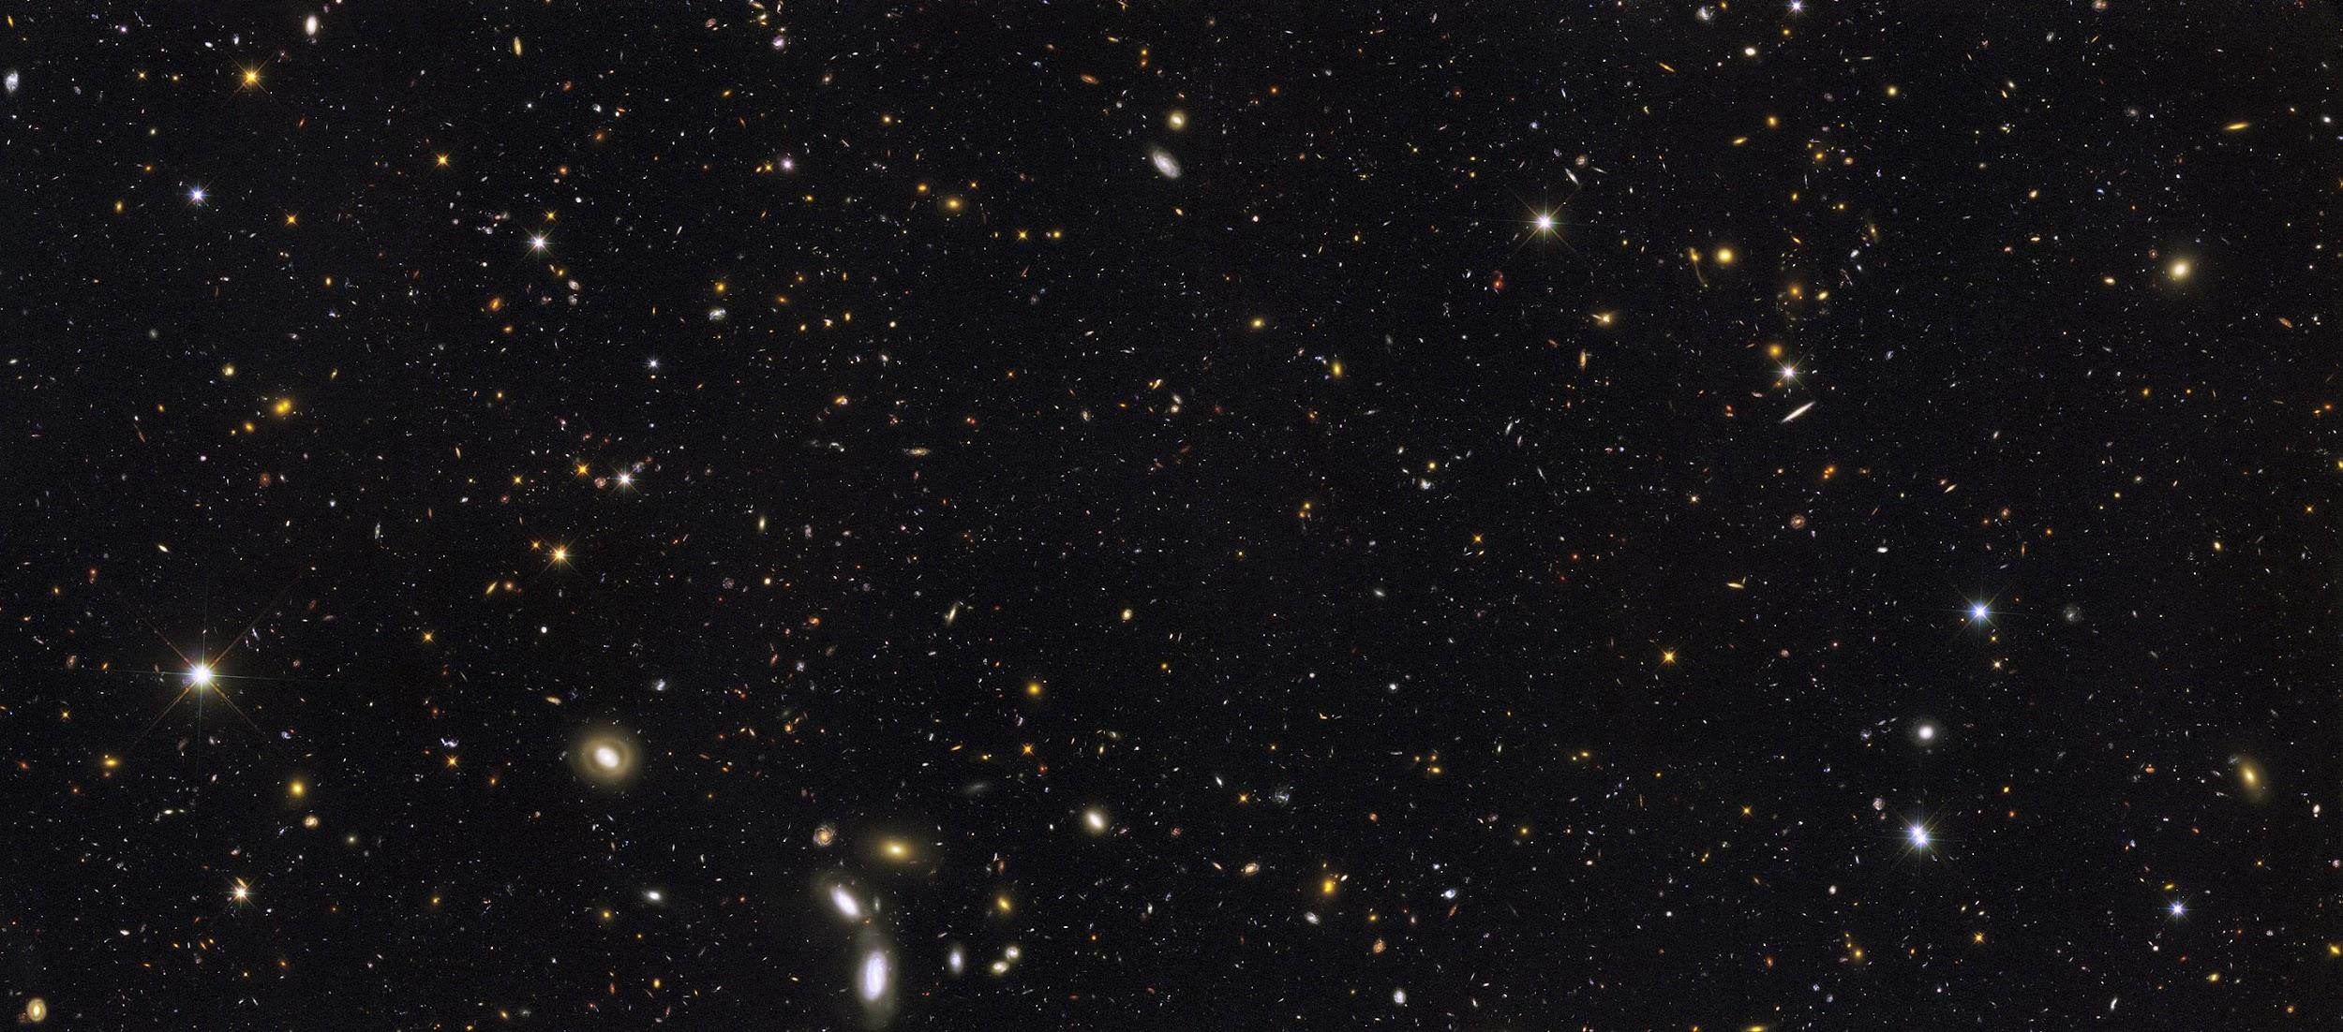
Background for the “Background”
We have set out to find possible signatures of a “gravitational background radiation” in available LIGO data.
GBR is predicted to be uniformly distributed and very subtle, gravitational waves left over from the violent and dense state of the very early cosmos
This is analogous to the Cosmic Microwave Background
The primary issue in finding GBR is identical to that which faced the discoverers of the CMB: the signal we seek is lost in the noise.

Slide 3
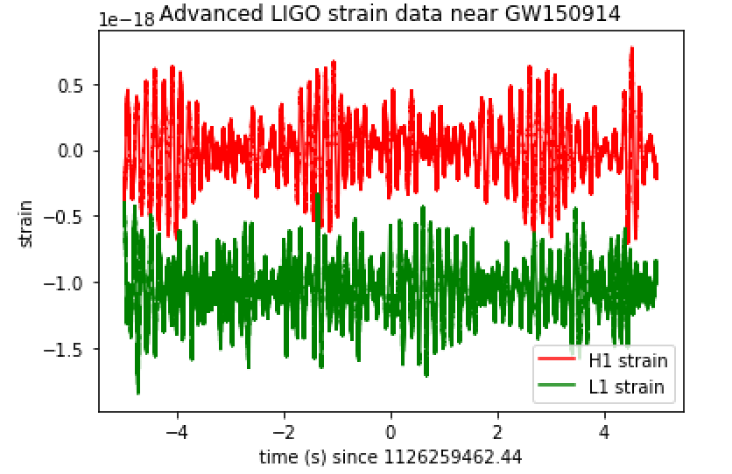
Strain
Following the tutorial available on the LIGO website, we produced a plot for the strains given during an event measured at the Hanford and Livingston sites
The signal is not visible in this plot; more data analysis is needed

Slide 4
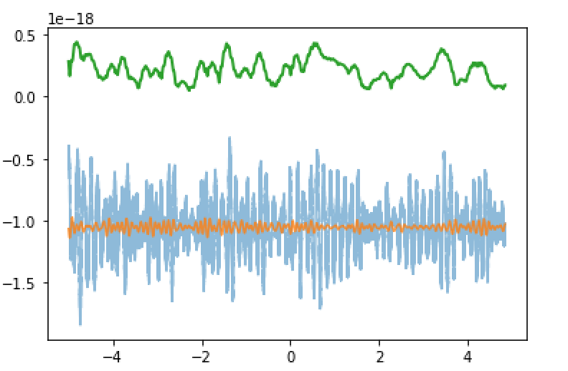
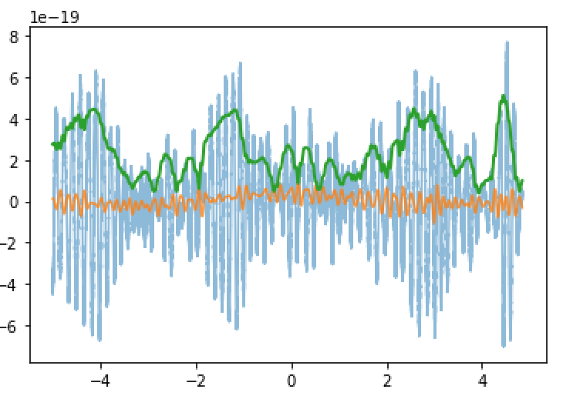
Rolling Standard Deviation
Our first step in breaking the data down was finding the rolling standard deviation.
The blue in these plots is the strain, the green is the RSD, and the orange is the mean.
The RSD has different altitudes for each reading because the Livingston data is deliberately offset, while the RSD is centered at 0

Slide 5
Whitened Data
The whitening process filters out both instrumental and fine noise, in order to make a gravitational wave event more noticable.
We originally opted to forego the whitening process, thinking that it might also filter out the subtle GBR signal, if it exists
However, after finding nothing interesting in the unwhitened data alone, we decided to also measure the whitened data.

Slide 6
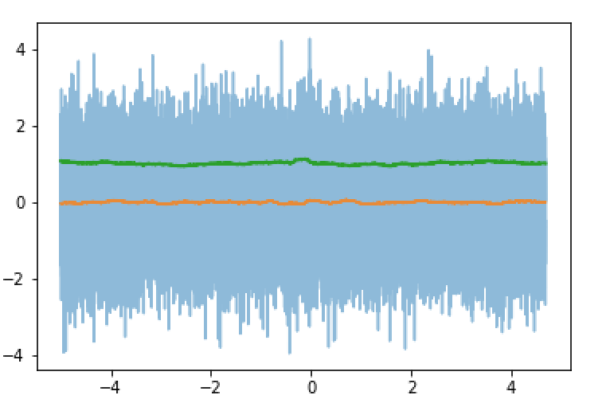
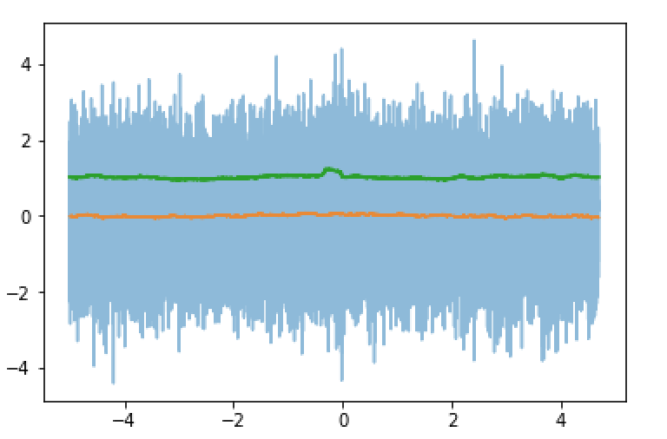
Whitened Data
What would make a signal obvious would be if the standard deviation bottomed out prematurely, indicating a uniform and recognizable noise at some frequency, i.e. GBR.
In both this whitened data and the unwhitened data shown previously, this is not seen, so there is more work to be done.

Slide 7
Next Steps
Thus far, we have been working with data collected from a black hole merger. Our next step is to analyze random data, not optimized to read a specific outcome. We would be looking for significant differences between the RST measured.
We have also thought of using the same technique used by the discoverers of the CMB: taking pot shots with Markov chain Monte Carlo algorithms. However, this is a time consuming process, one which may not be possible to complete within the semester.

